Slide 1
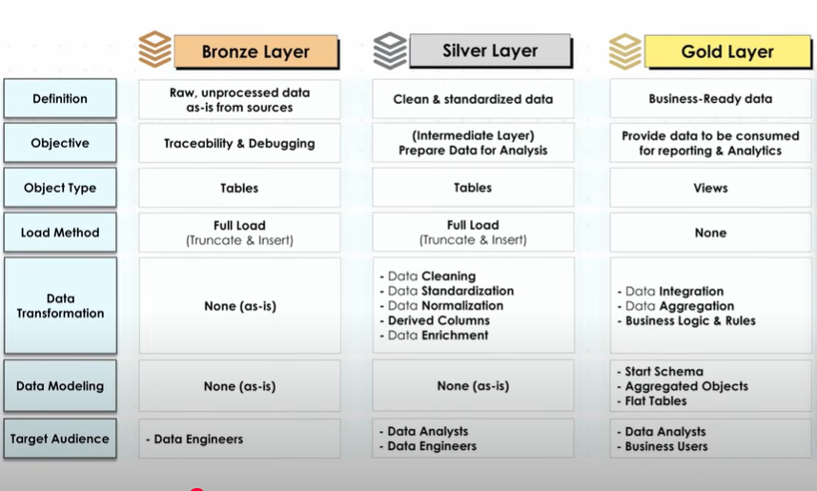
Data Warehouse Project layout

Slide 2
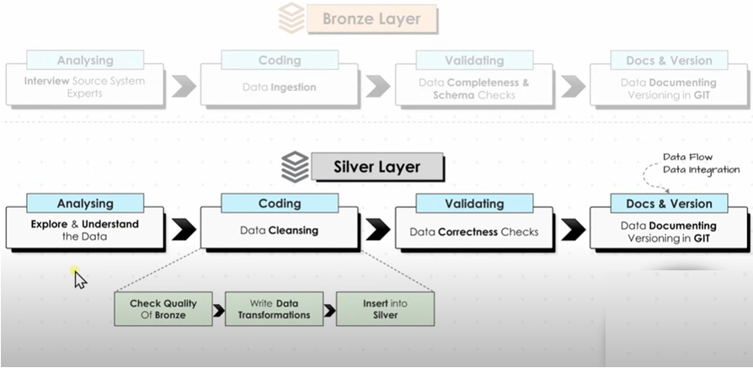
Data Warehouse Project layout

Slide 3
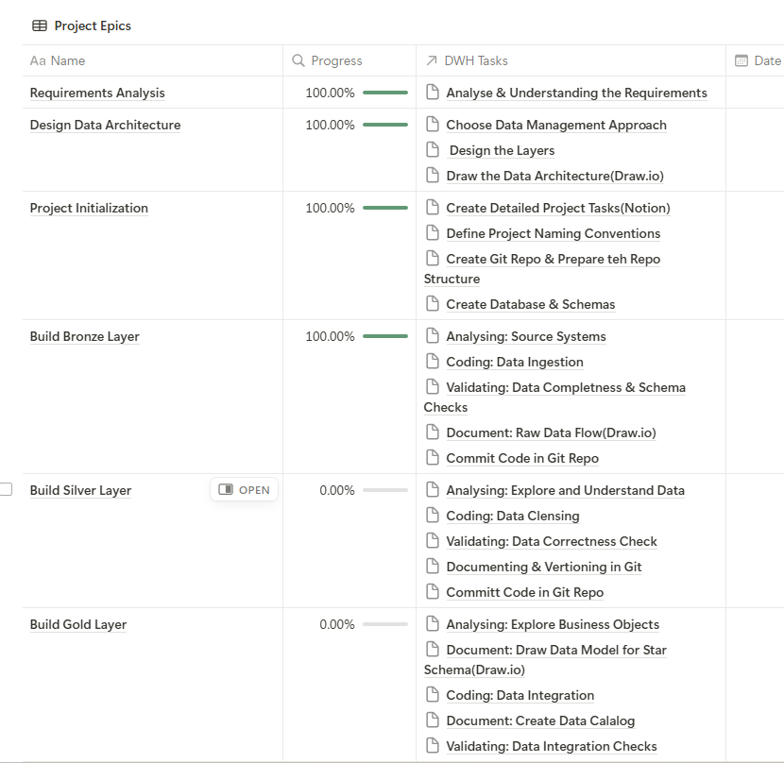
Data Warehouse Project- notion

Slide 4
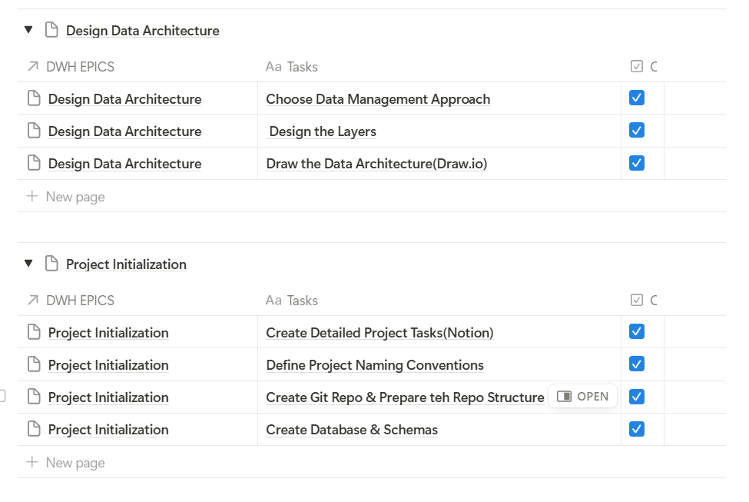

Data Warehouse Project Tasks- notion

Slide 5
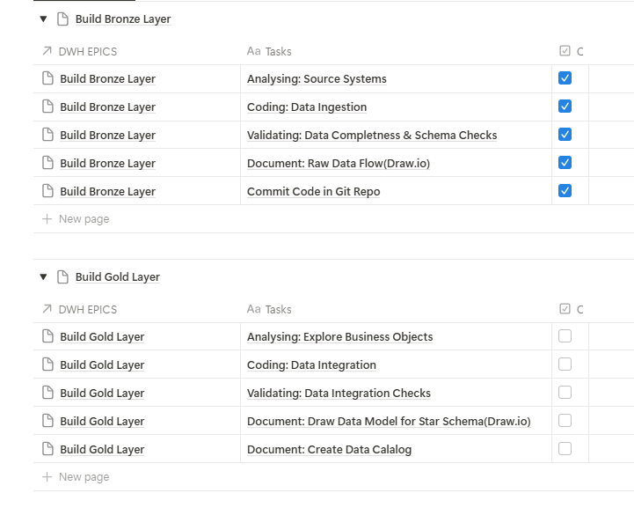
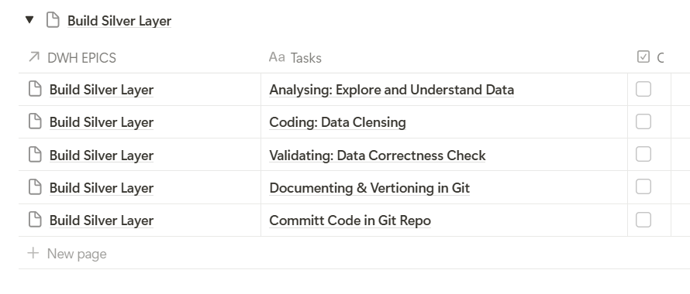
Data Warehouse Project Tasks- notion

Slide 6
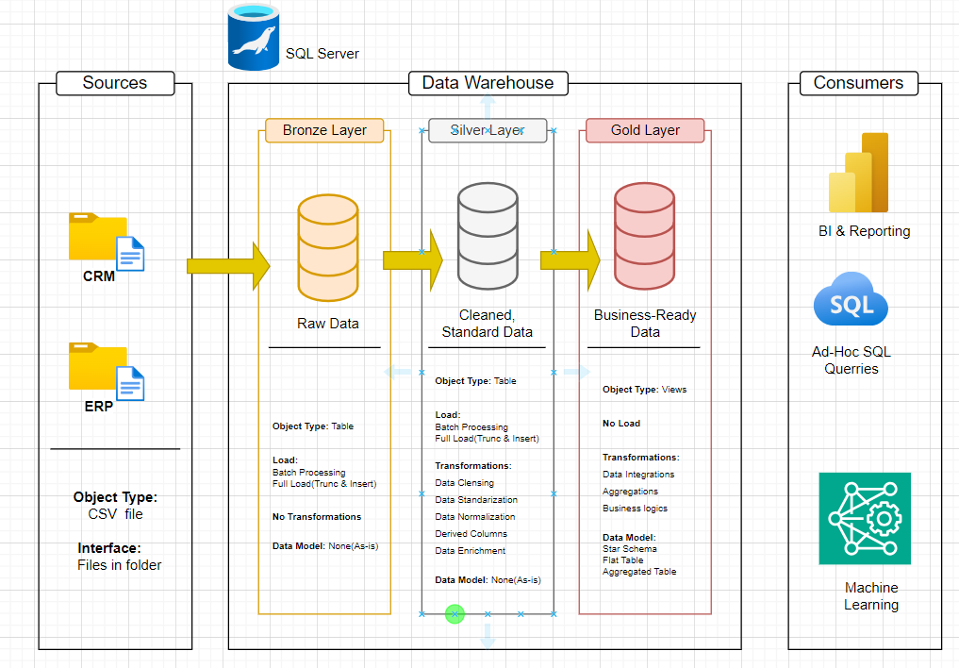
Data Diagram

Slide 7
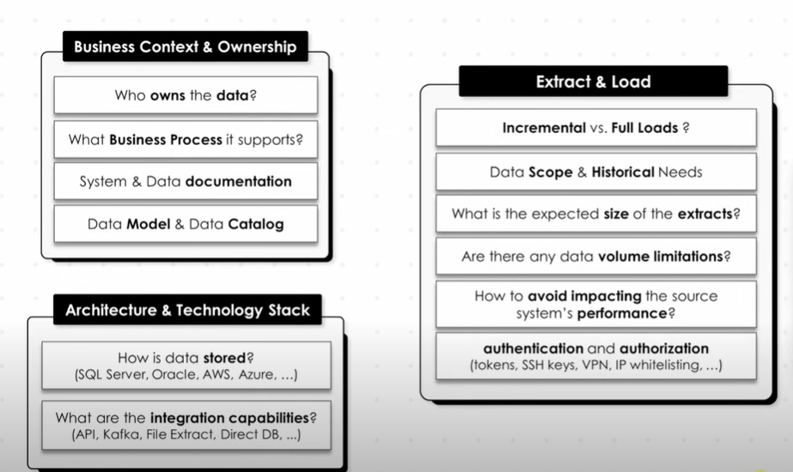
Build Bronze Layer- Analysing: Source Systems

Slide 8

Gold Layer Architecture

Slide 9
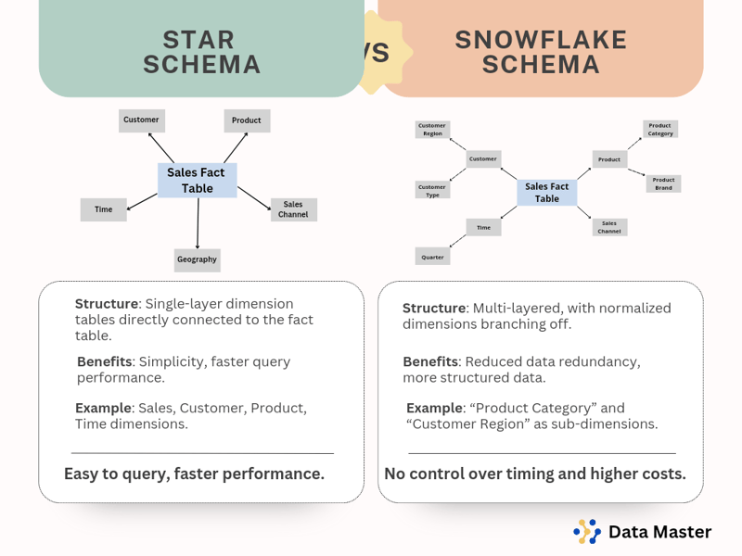

Slide 10
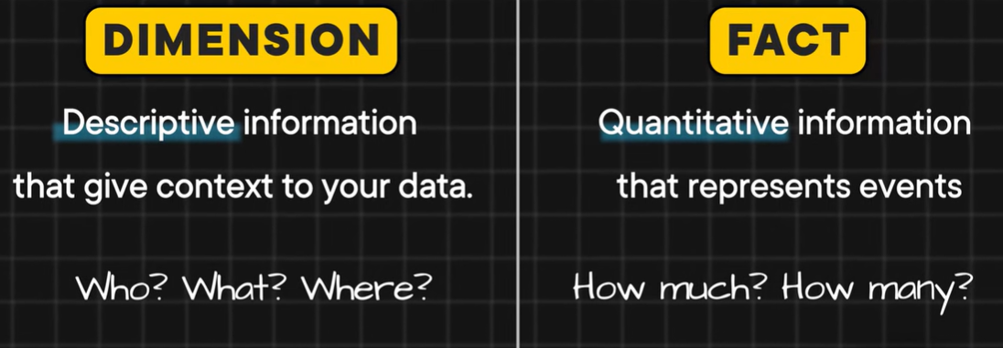

Slide 11
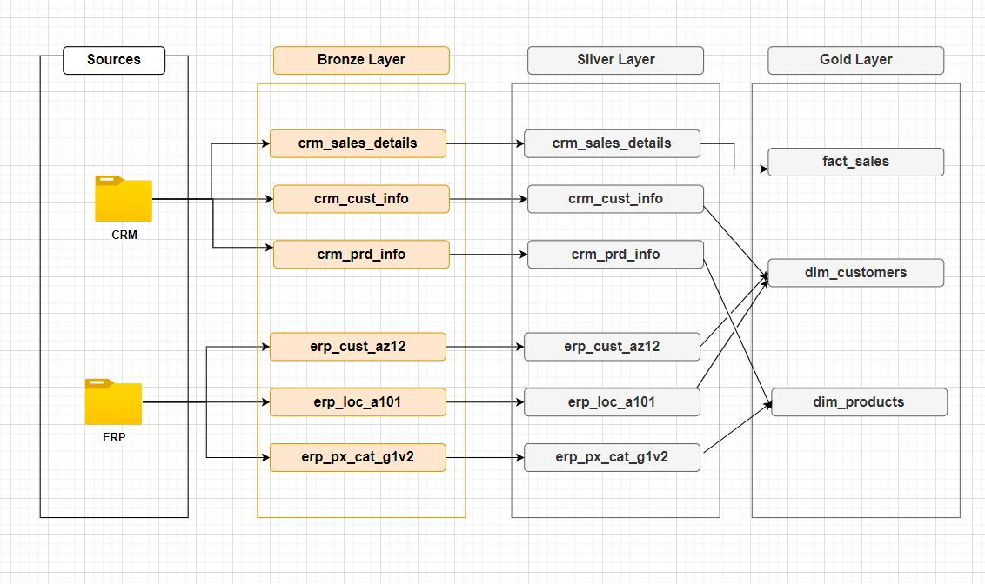
CRM and ERP

Slide 12
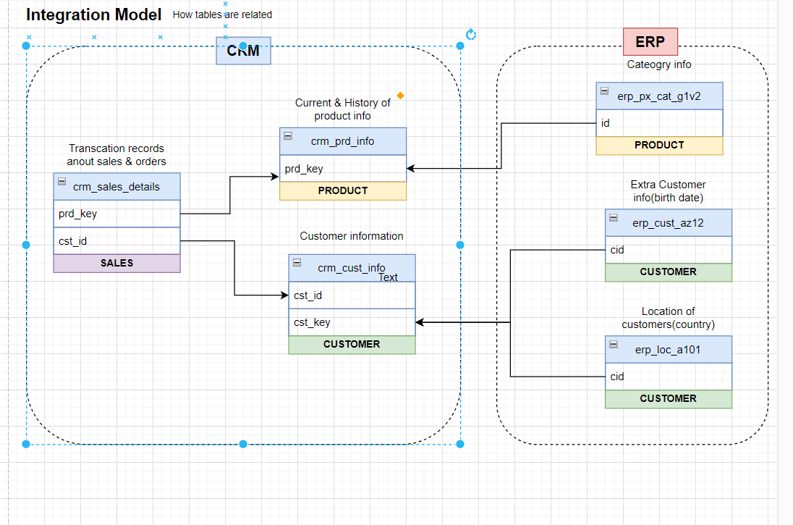

Slide 13
